Slide 1
Bluetooth Basics
What is Bluetooth - done
Bluetooth Chip vendors - done
Bluetooth stack vendors - done
What are versions of Bluetooth stack - done
Range of Bluetooth devices - Done
Different protocols
Different profiles
How does bluetooth works – hopping, frequency range etc.

Slide 2
Bluetooth Basics
Basic chaacters of bluetooth devices –
How many devices can be connected and paired to Master
Master slave communication
Piconet
Scatternet
Sleep mode
Park mode
Active mode

Slide 3
Bluetooth Basics
What is maximum number of devices can be connected to master device
How connection estanlished between two devices
Link key
Simple pairing
Legacy pairing
Paging
Inquiery
Connection
Pairing

Slide 4
Bluetooth Range
A Bluetooth technology is a high speed low powered wireless technology link that is designed to connect phones or other portable equipment together. It is a specification (IEEE 802.15.1) for the use of low power radio communications to link phones, computers and other network devices over short distance without wires. Wireless signals transmitted with Bluetooth cover short distances, typically up to 30 feet (10 meters).
Class Maximum Power Operating Range
Class 1 100mW (20dBm) 100 meters
Class 2 2.5mW (4dBm) 10 meters
Class 3 1mW (0dBm) 1 meter

Slide 5
Data rate:
Specifications Bluetooth 1.0 - 721 kbit/s
Bluetooth 1.2 - 721 kbit/s
Bluetooth 2.0+EDR - 2.1 Mbits/s
(enhanced data rate) Bluetooth 2.1+EDR - 3 Mbits/s
(enhanced data rate) Bluetooth 3.0 HS - 24 Mbit
Bluetooth Low Energy 4.0 – 1 Mbits(power .01 to .5 watts), since it is sleep mode data transmission is less. BLE device that can reliably transmit data 30 meters or more line-of-sight, but a typical operating range is probably closer to 2 to 5 meters. Of course, the higher the range the more battery consumption, so take care when trying to tweak your device for higher range.Over the air data rate is 125 kbit/s – 1 Mbit/s – 2 Mbit/s

Slide 6
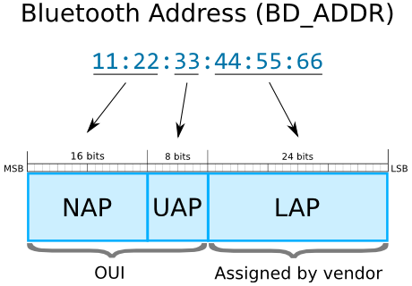
48 bit BD address -
NAP
Non-significant Address Part (2 bytes). Contains first 16 bits of the OUI. The NAP value is used in Frequency Hopping Synchronization frames.
UAP
Upper Address Part (1 byte). Contains remaining 8 bits of the OUI. The UAP value is used for seeding in various Bluetooth specification algorithms.
LAP
Lower Address Part (3 bytes). This portion of Bluetooth Address is allocated by the vendor of device. The LAP value uniquely identifies a Bluetooth device as part of the Access Code in every transmitted frame.
The LAP and the UAP make the significant address part (SAP) of the Bluetooth Address.

Slide 7
Basic data packet transfer
• Preamble – 01010101 or 10101010
Access Address – Lower address part of BD address. 32 bit.
CRC – 24 bit CRC for robust bit error detection
Preamble Access Address Payload CRC
1 byte 4 bytes 32 bytes 3 bytes

Slide 8
Bluetooth
Bluetooth is deleloped by Ericsson in 1994 as an alternative to wired communcation between mobile and other devices.
In 1998, the companies Ericsson, IBM, Nokia and Toshiba formed the Bluetooth Special Interest Group (SIG) which published the 1st version in 1999.
Bluetooth Chip vendors are Broadcom, Marvel, Cypress
Stack vendors : Opensynergy, Bluez is the stack developed for Linux kernel. And it is developed by Qualcomm, and is available for Linux kernel versions 2.4.6 and up.fluoride bluetooth stack is used in Android.

Slide 9
Bluetooth protocol
LT_ADDR – Logical Transport Address
The 3-bit LT_ADDR field contains the logical transport address for the packet (see Section 4.2). This field indicates the destination slave (or slaves in the case of a broadcast) for a packet in a master-to-slave transmission slot and indicates the source slave for a slave-to-master transmission slot.
LT_ADDR is valid only till slave is in active mode. Once it is diconnected, it will lose LA_ADDR.

Slide 10
connection
Inquiry ------ inquiry scan
Page ------ page scan mode
Connection happens with slave

